Slide 1
ATM SYSTEM
DHARANI PRASAD.S-1831013
SYED MOHAMMED .N - 1831055

Slide 2
IDEA
Implementing an ATM SYSTEM using Assembly Language Programming in 8086.

Slide 3
CONCEPTS USED
Concepts used to build a static ATM SYSTEM are
Arrays
Switch Cases(Different Modules of Operation)
Exception Handling
Simple Mathematical calculations.

Slide 4
FUNCTIONALITIES
Pin Verification
Withdrawal
Deposit
Balance enquiry
Keeping Track of attempts(If User enters a wrong Login PIN)

Slide 5
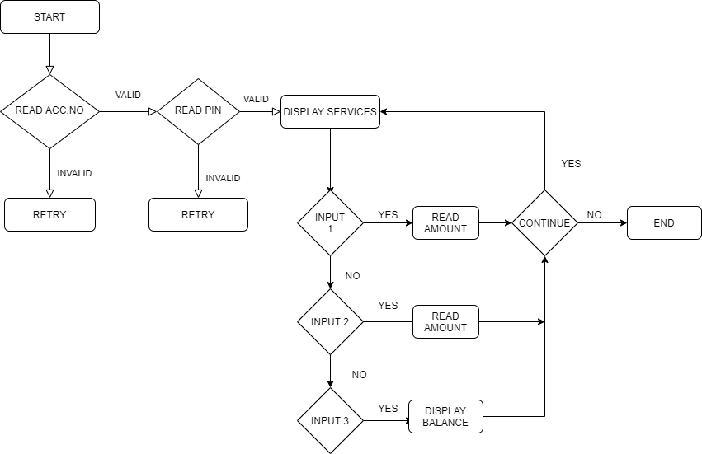
FLOWCHART

Slide 6
THANK YOU

